Slide 1
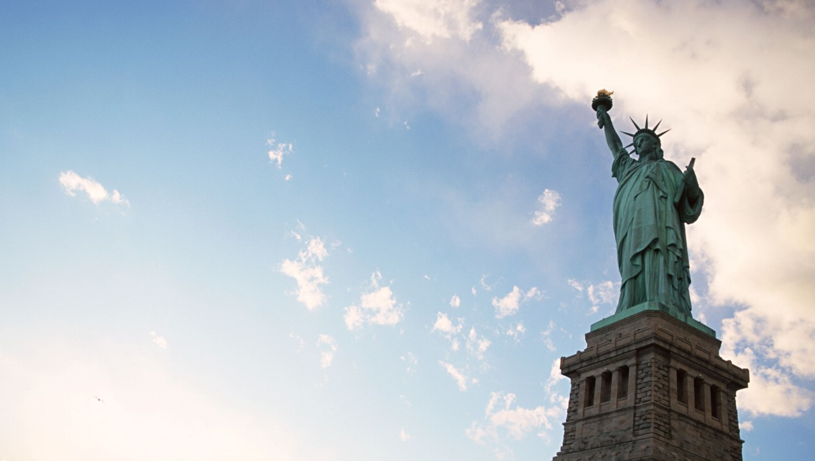


不疯魔，不成活
——天津新东方
李劲

Slide 2
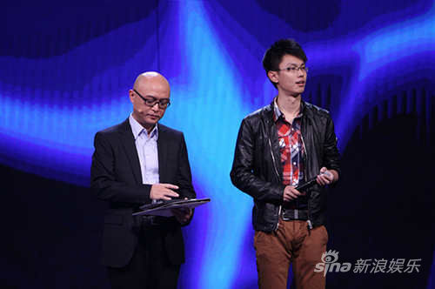
非诚勿扰-单词量不一样怎能在一起
2

Slide 3
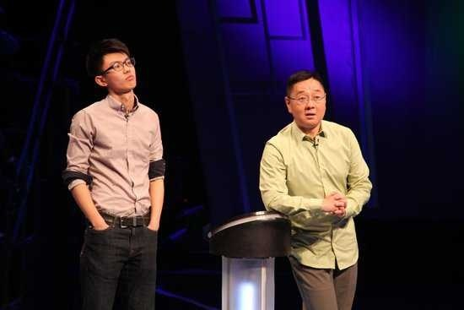
广西卫视
3

Slide 4
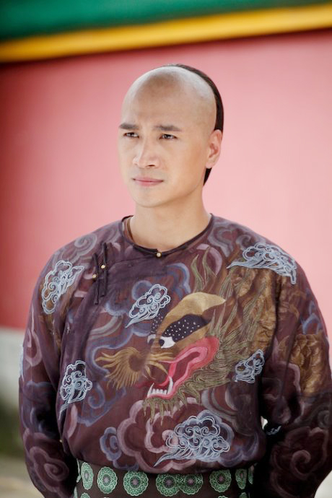
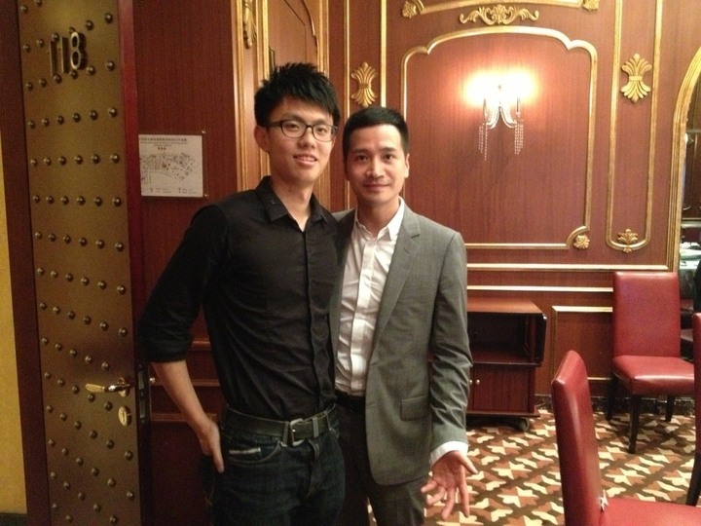
差点成为“帝师”
4

Slide 5
“人们对机会的估值过高，这是我在下棋的时候学到的一点。你其实只需要一个好的选择就行，没必要同时去追求 A、B、C、D。”——Peter Thiel
Notes:
莫泊桑 福楼拜
詹姆斯卡梅隆
机会成本

Slide 6

大一：加入了APEX社团
大二：参加全国比赛
大三：参加国际比赛
大四：继续传播辩论教育

Slide 7
Format of American Parliamentary (AP) Style
Proposition
1st Speaker/PM (7m)
2nd Speaker/DPM (7m)
Reply Speaker (4 m)
(1st Speaker only)
Opposition
1st Speaker/OL (7m)
2nd Speaker/DOL (7m)
Reply Speaker (4 m)
(1st Speaker only)
7

Slide 8
Different Formats of Debates:
Asian
3 members to a team
POIS are allowed.
British Parliamentary (Worlds Debates)
2 member to team and 4 teams in a debate
POIs are allowed
Closing Gov.
Opening Gov.
Set up in a British Parliamentary Format of Debate
Speaker/ Chair
Closing Opp.
Opening Opp.
8

Slide 9
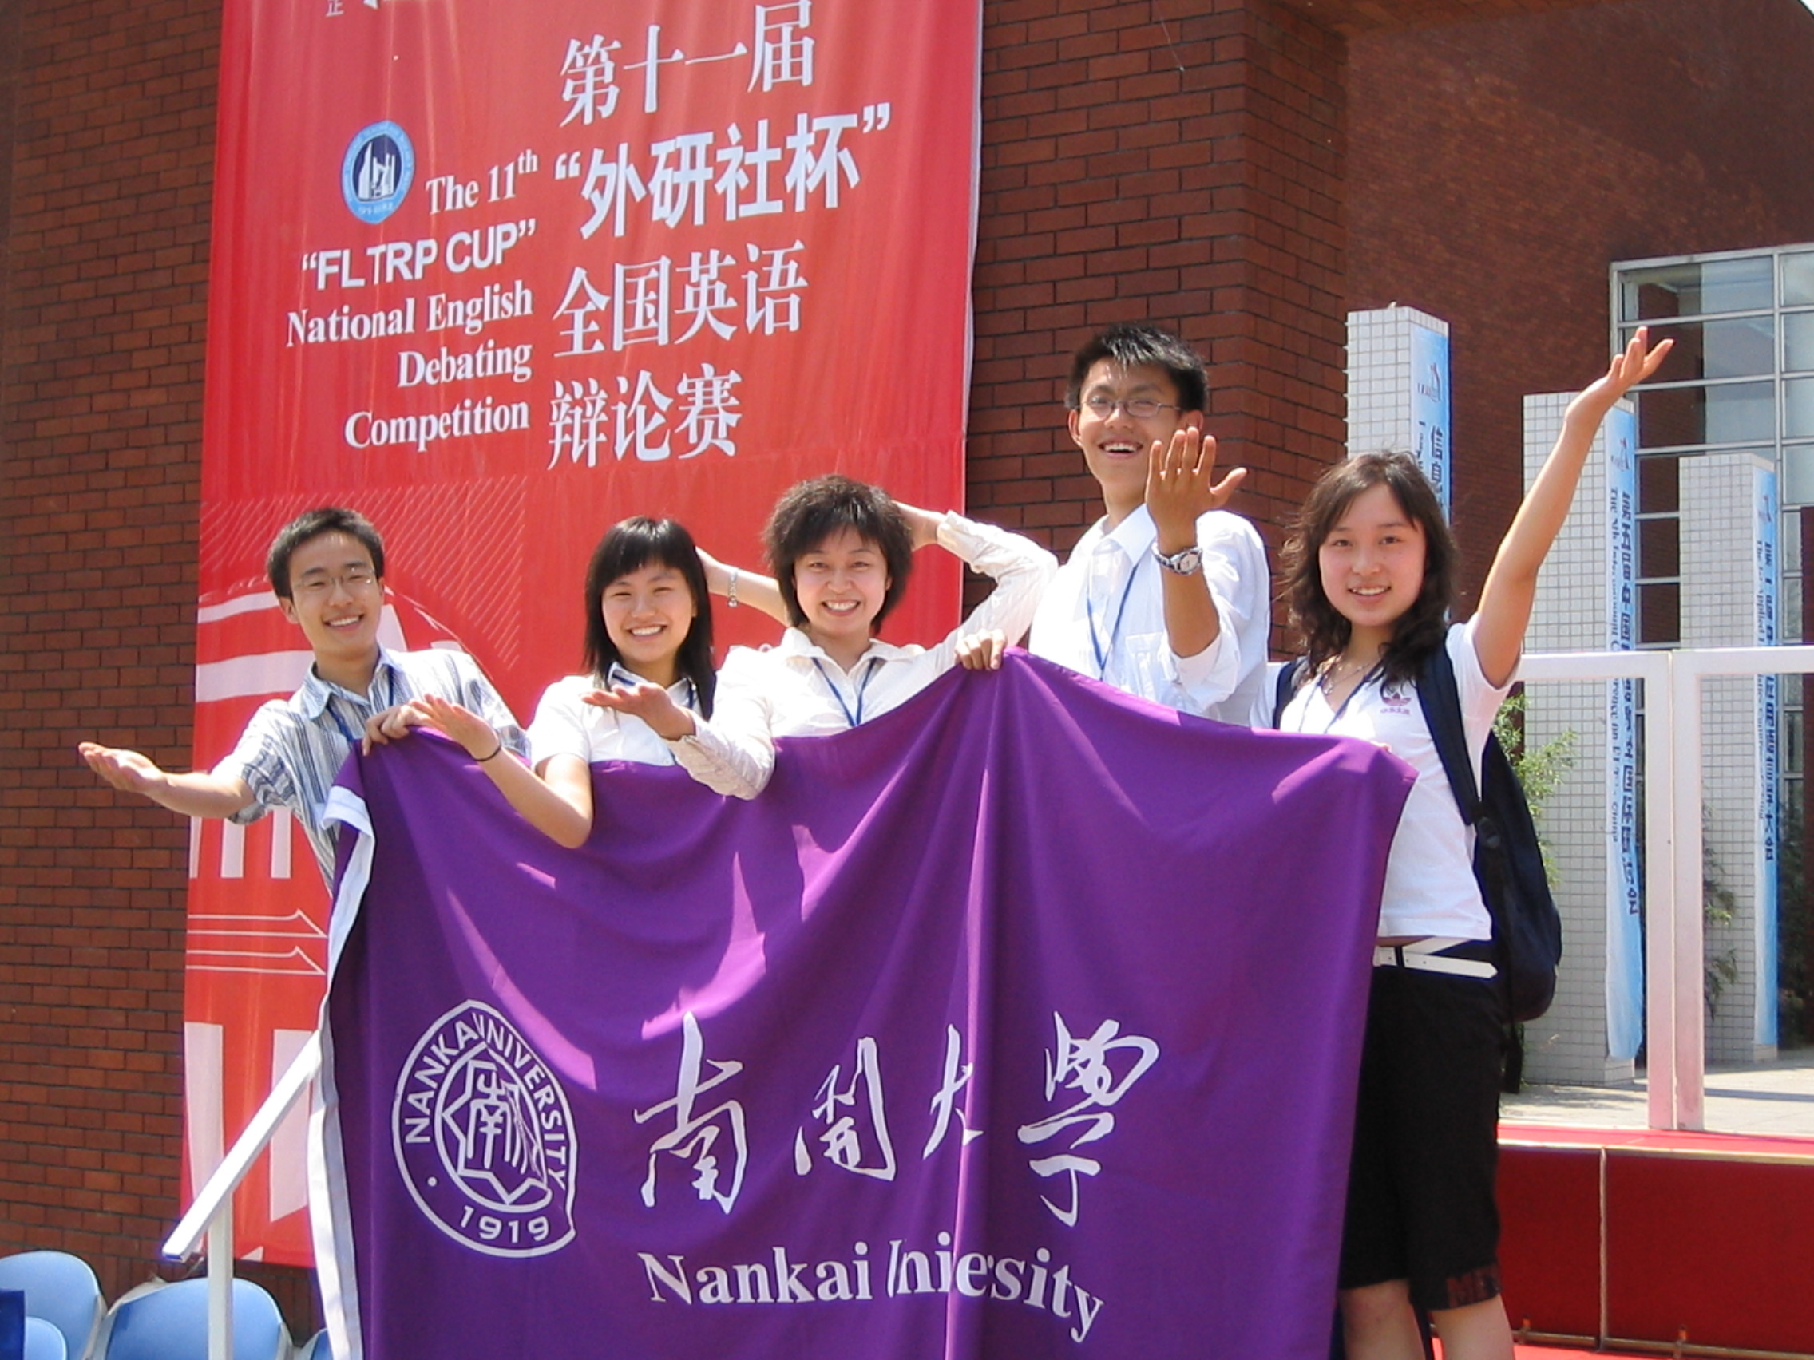
Notes:
遇到对手很厉害

Slide 10
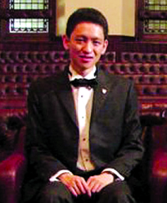
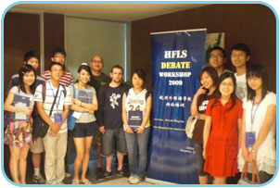
Who are debating
前世界最佳辩手
李光耀贤孙李绳武
杭州外国语学校的“精英”中学生

Slide 11
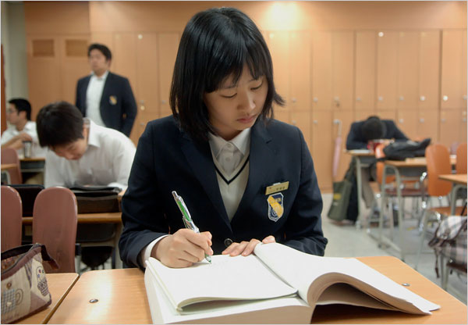
2013年SAT平均分：2203
133名学生全部
美国TOP50
34人考入常青藤院校
韩国大元外国语中学
Notes:
来自09年ADI辩论的震撼

Slide 12
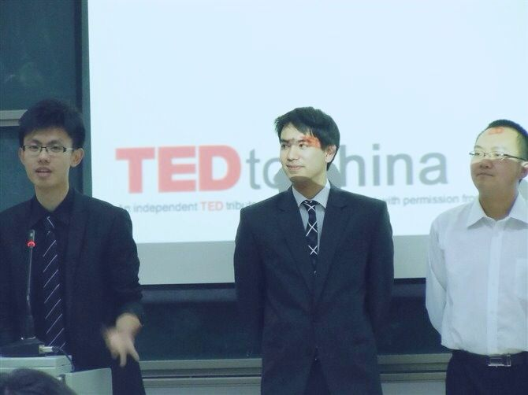
TED talk
Standardized test (T/S/G/G/I)
Paper/thesis/dissertation
Presentation/interview
Insight/character building
Quibble/wrangle/squabble
Show off….

Slide 13
局长秘书
房产销售
新东方老师

Slide 14
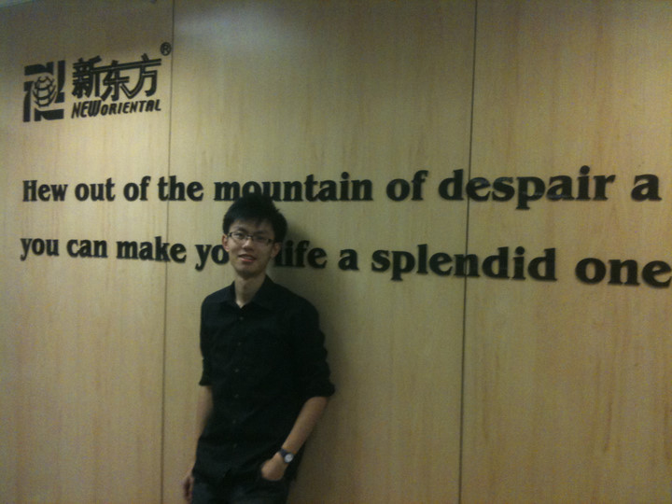
绝望中寻找希望
第一次上课
第一次投诉
第一次连十

Slide 15
关于词汇
8000左右
12000的词汇量是你的底线。
到外文书店去找一本美国著名的周刊《Times》，你不必买，在书店里就地翻看下即可，找一篇UNITED STATES栏目下的文章阅读。如果，你读的感觉是“非常”顺畅，你的词汇量已高达12000。“非常”的定义就是你用停顿下来思考文章所表达的意思。如果，你读的感觉是“很”顺畅，你的词汇量在8000-10000上下，属于这个范围的同学，你读这本周刊里的Global investing栏目就会感到非常顺畅。如果，你读的感觉是“似懂非懂”，你的词汇量在5000-7000。如果，你读的感觉是头晕，那你的词汇量不足5000。

Slide 16
Alex wrapped all the savory ingredients around a succulent piece of lettuce and after taking a bite, he said: this'd be a kind of culinary perfection.

Slide 17
Alex wrapped all the savory ingredients around a succulent piece of lettuce and after taking a bite, he said: this'd be a kind of culinary perfection.

Slide 18



Slide 19
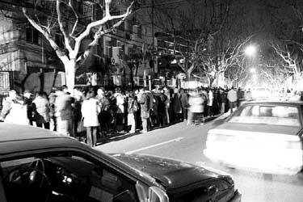
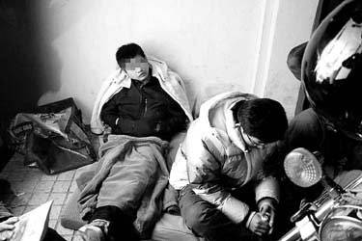
Notes:
上海1600人连夜排队领老托福报名表2006/03/07
美国大学退学率 15%

Slide 20
口语水平和口语分数是一回事么?

Slide 21
Our problems
Concept 观念: Chinese way and the western way
Concrete Content 实质内容
Grammar 语法
Pronunciation 发音

Slide 22
Our problems
Concept 观念: Chinese way and the western way
Concrete Content 实质内容
Grammar 语法
Pronunciation 发音

Slide 23
Our problems
Concept 观念: Chinese way and the western way
Concrete Content 实质内容
Grammar 语法
Pronunciation 发音

Slide 24
说具体
Get your audiences clear 用词用句要精准，举例要恰当:
EG: 在电影院看电影太贵了
Translation 1：watching movies at cinema is too expensive.
Translation 2: watching movies at theater costs me a great deal of money(kind of dig a hole in my pocket), for example Titanic, the one and only epic romance, is shown in the theater, I have to pay $30 for the ticket!

Slide 25
Logical plots：细节要充足，有逻辑
EG：我不喜欢和父母交谈，因为他们老了
因为他们老了：他们50岁，而我只有20岁
所以我们之间有很深的代沟，也就是说
我们没有共同话题，无法彼此了解，比如：
我喜欢打Dota，而我父母从不知道Dota是什么，
他们只喜欢太极拳
所以我不喜欢和父母交谈

Slide 26
Our problems
Concept 观念: Chinese way and the western way
Concrete Content 实质内容
Grammar 语法
Pronunciation 发音

Slide 27
Our problems
Concept 观念: Chinese way and the western way
Concrete Content 实质内容
Grammar 语法
Pronunciation 发音

Slide 28
：Pronunciation
Long/short vowel 长短元音
Seat/sit
Sheep/ship cultural difference.mp4
Receive
Beach & BXXch,
sheet/shXt

Slide 29
：Pronunciation
Common Mistakes
Diphthong 双元音
name/plane/Jane/baby/cake [ei]
inspire/Smile/drive/time/ride/Strip [ai]
now/out/how/found/doubt [au]

Slide 30
Pronunciation
Common Mistakes
Others
quality/quote/equal，between
soup & soap
Fuck fork

Slide 31
Subject：Pronunciation
Common Mistakes
Others
world/walk/work
valuable/usually
photographer/advertisement

Slide 32
Subject：Pronunciation
爆加爆 big deal
爆加磨 sad song
爆加鼻 let me

Slide 33
How to improve my oral English
Content 内容
Why为什么练？
What 练什么？
How 怎么练？

Slide 34
How to improve my oral English
Why 为什么练？
$
Communication
Practical use
Notes:
Read, listen, write, speak

Slide 35
How to improve my oral English
What 练什么？
Slang?
I’m the third wheel
Bite me
Chick digs this shit
Useful content!
TOEFL 真题（突破哦、机经）

Slide 36
How to improve my oral English
Not Recommended materials
American movies or TV dramas: Prison Break, Gossip Girl, Game of thrones

Slide 37
俚语的四个属性
Vulgar
Cultural
Dynamic
Humorous

Slide 38
bitch(1): a very unpleasant woman
eg: My boss can be such a bitch sometimes.
bitch(2): complain
Stop bitching and finish yr homework!
bitchy: moody
eg: I like my friend Steve, even though he can be really bitchy.

Slide 39
俚语的四个属性
Vulgar
Cultural
Dynamic
Humorous

Slide 40
catch some Zs
ammunition: toilet paper(卫生纸）（其实此词有弹药的意思，但是美国人把它作为卫生纸的意思，挺有趣的）
eg: "Help! We're completely out of ammunition!"

Slide 41
俚语的四个属性
Vulgar
Cultural
Dynamic
Humorous

Slide 42
Gadar: turn one’s gadar off
Eg: my gadar is alarming
Asian glow
speak Greek/Chinese

Slide 43
俚语的四个属性
Vulgar
Cultural
Dynamic
Humorous

Slide 44
skiddo groovy
Dope swell
合成：smog motel brunch groupon
遵循省力原则：
Ish/mega/
$: cheese cabbage beans

Slide 45
美剧观赏的四个维度
Comedy
Documentary
Mini series
Drama

Slide 46
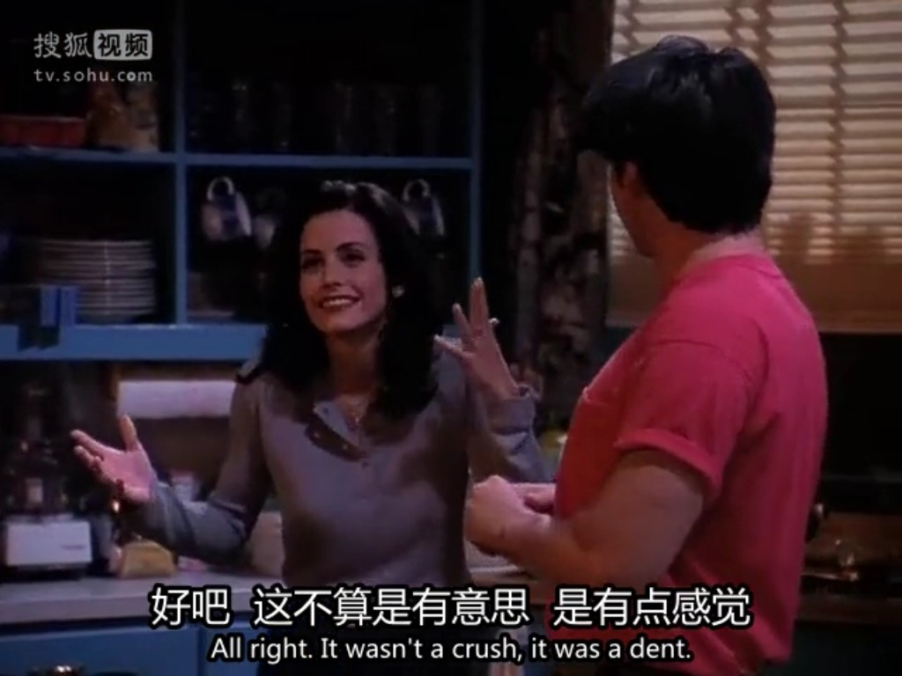

Slide 47
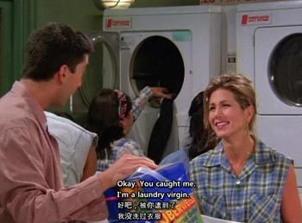

Slide 48
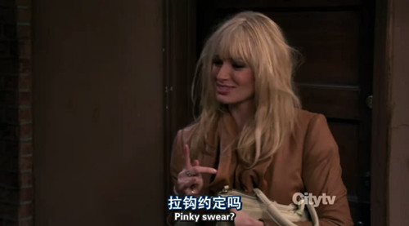

Slide 49

IMDB： 9.5
教授和痞子的对话
Better call Saul

Slide 50
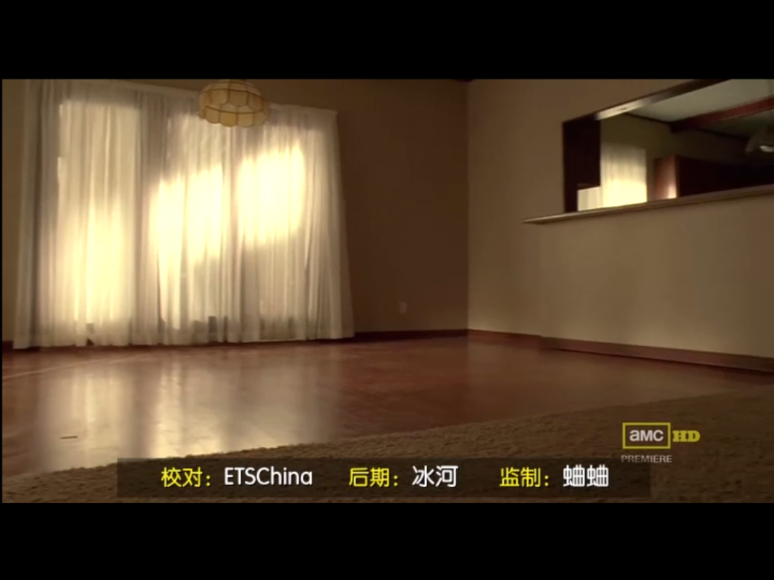

Slide 51
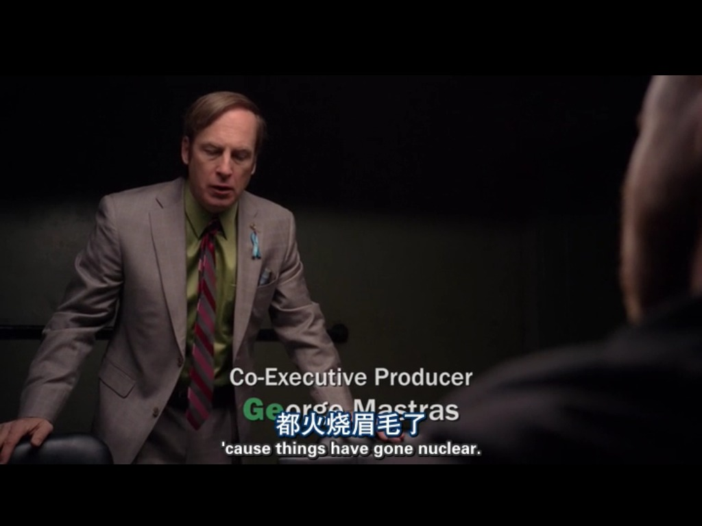

Slide 52
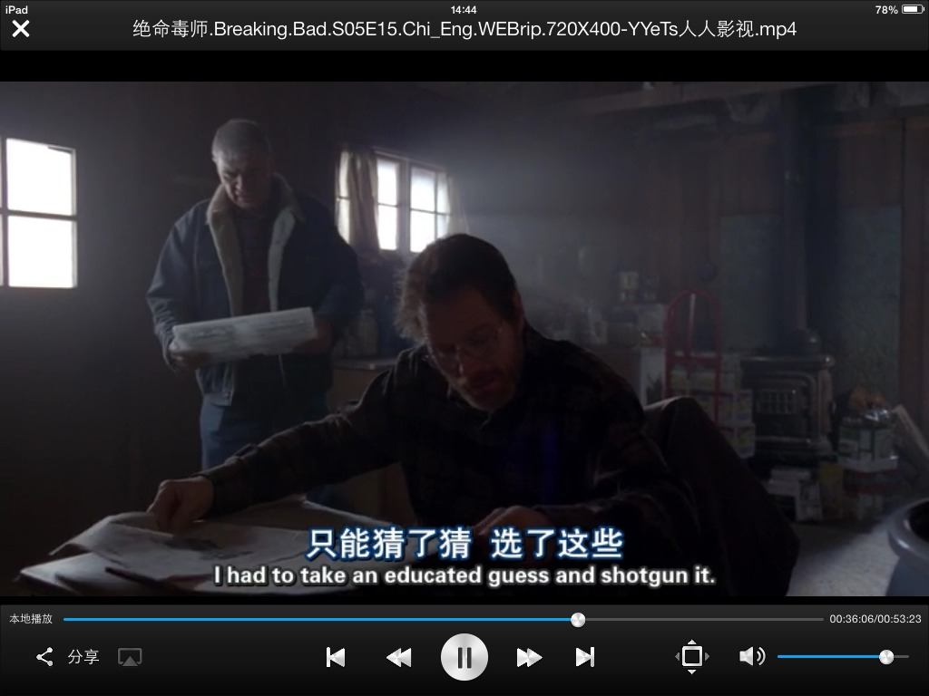

Slide 53
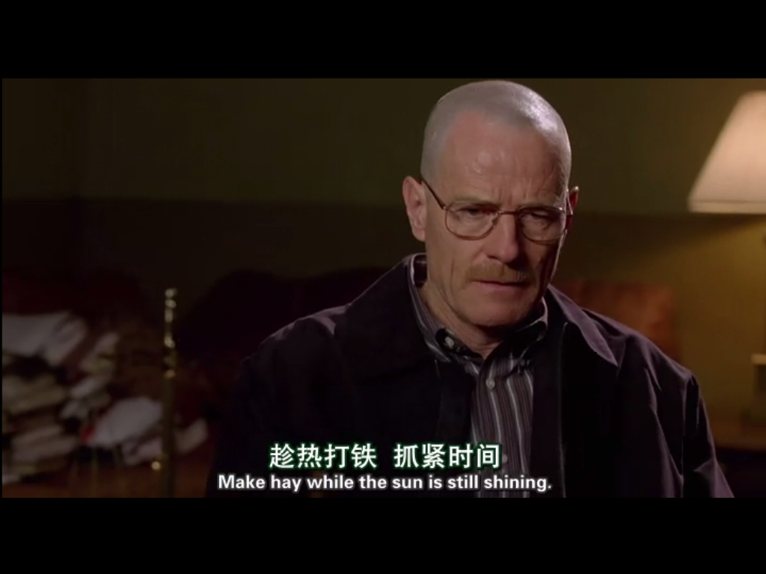

Slide 54
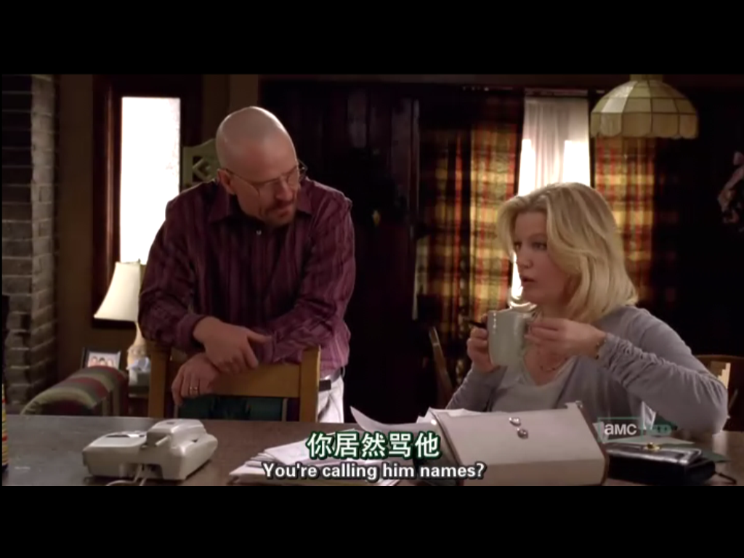

Slide 55

IMDB 8.7
四次艾美奖 最佳剧情
63届 艾美奖 19次提名
《广告狂人》中没有火辣的性爱场面，没有天赋异秉的奇人异士，也没有扣人心弦的破案追凶，但它有一样其他美剧都没有的法宝，那就是无可救药的“怀旧”。

Slide 56
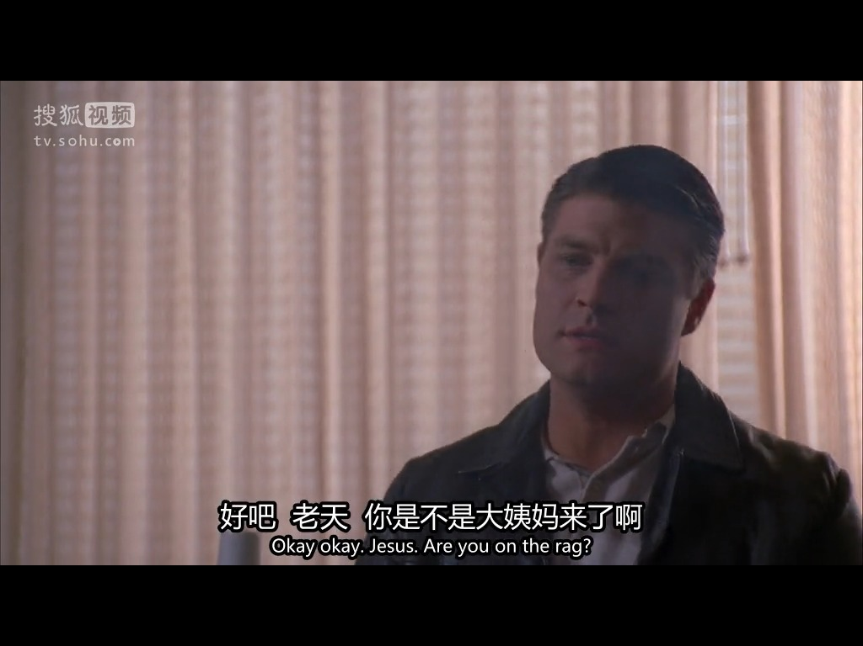

Slide 57
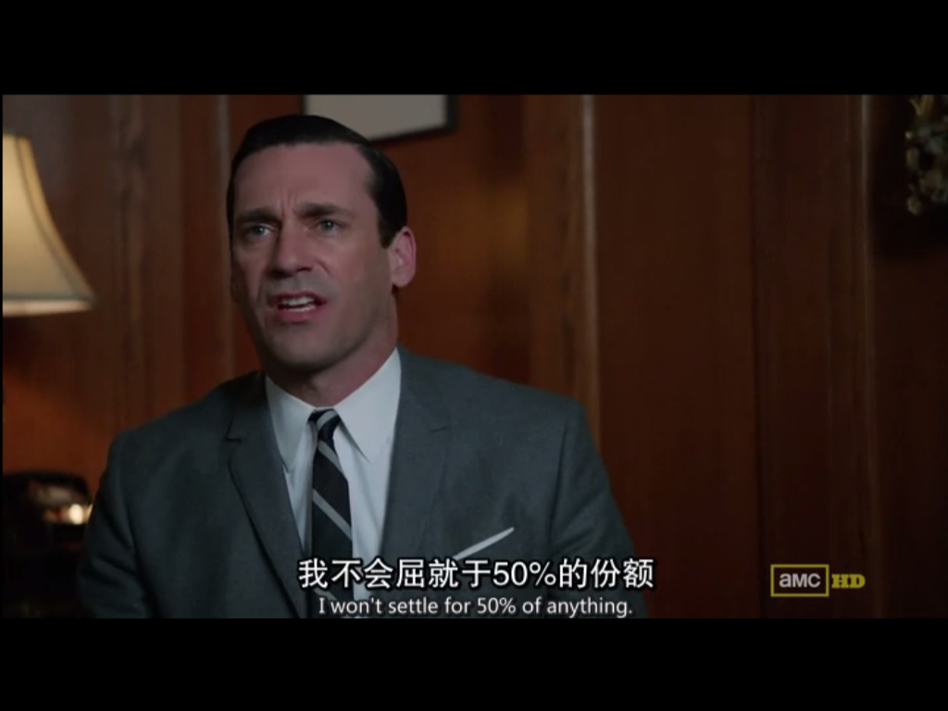

Slide 58
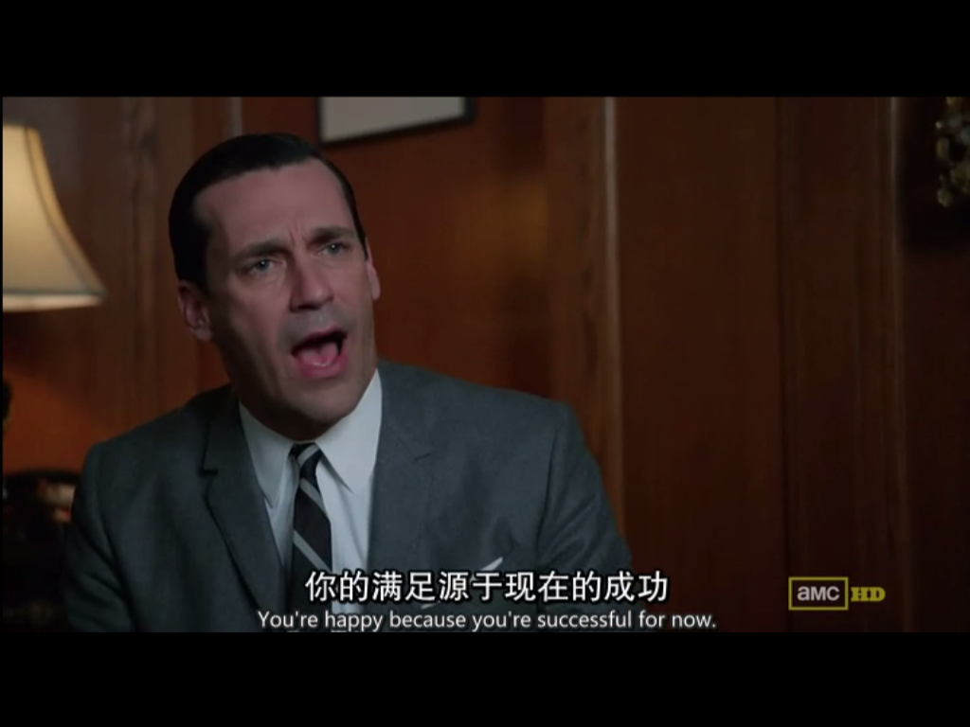

Slide 59
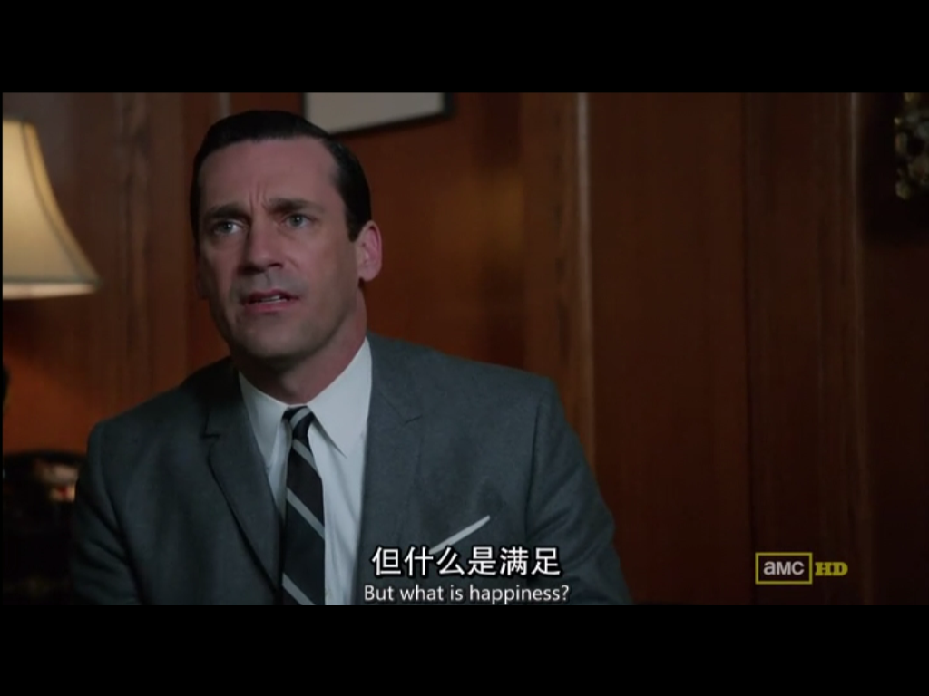

Slide 60
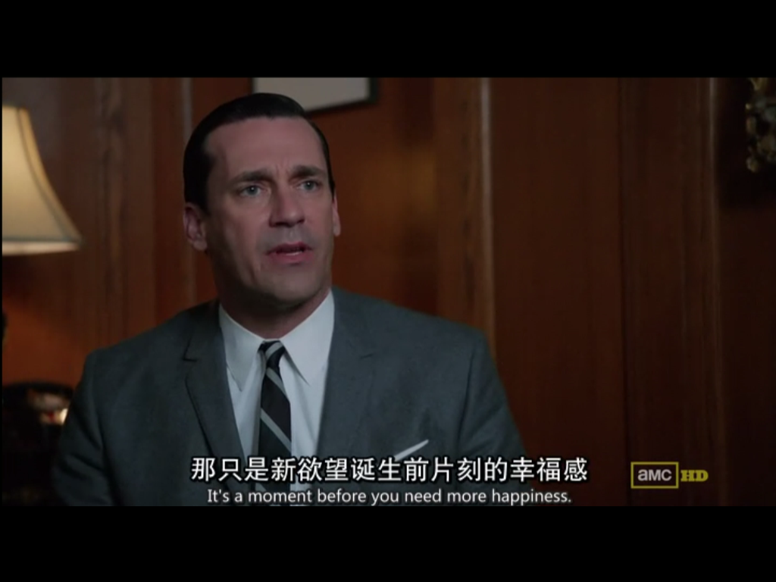

Slide 61

IMDB：8.7
Slang和vulgar words
LGBT
White trash/ Scum bag

Slide 62
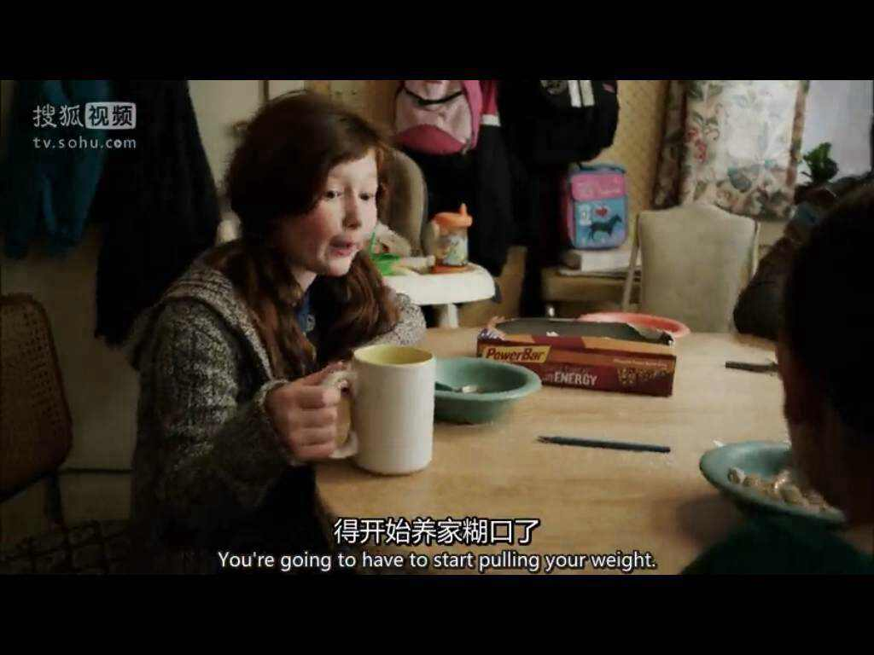

Slide 63
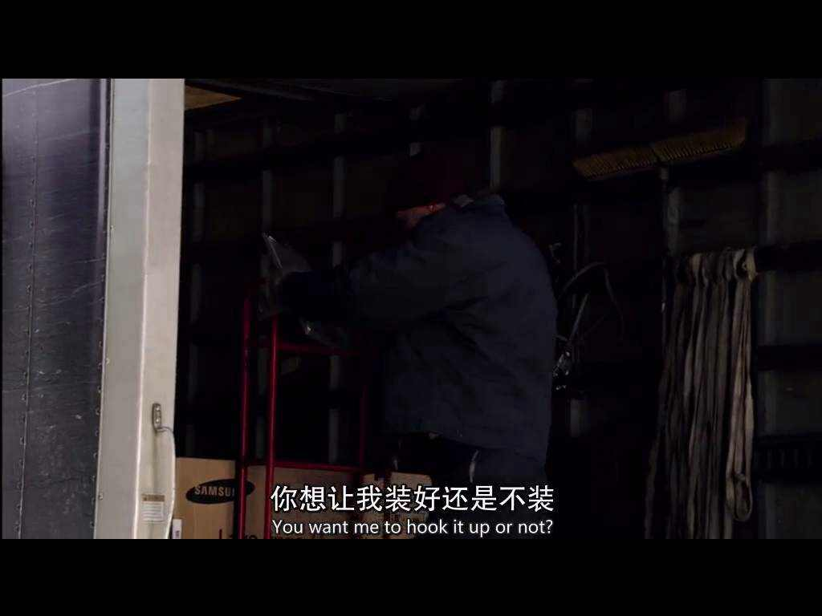

Slide 64
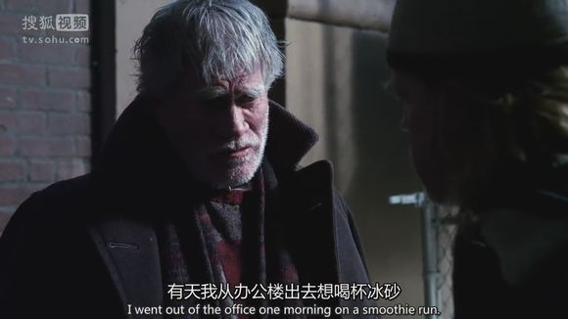
On a… run
Smoothies 奶昔

Slide 65
学习无处不在
排除干扰品味孤独
要有“狼性”
“羞耻”地活着
内功与招式并重
65

Slide 66
We will be living in the consequences of today!

Slide 67
海到无涯舟作岸，
山临绝顶我为峰。

Slide 68

谢谢

Slide 70
lijin6@xdf.cn
QQ: 702107962
Wchat: alexlijin

