Slide 1



Travel Overseas
——”生存英语”趣谈
主讲：李嘉益

Slide 2




Travel Overseas
医
食
住
行

Slide 3
Travel Overseas
预订酒店
Booking Room
入住酒店
Checking in
退房结账
Checking out
住 宿

Slide 4
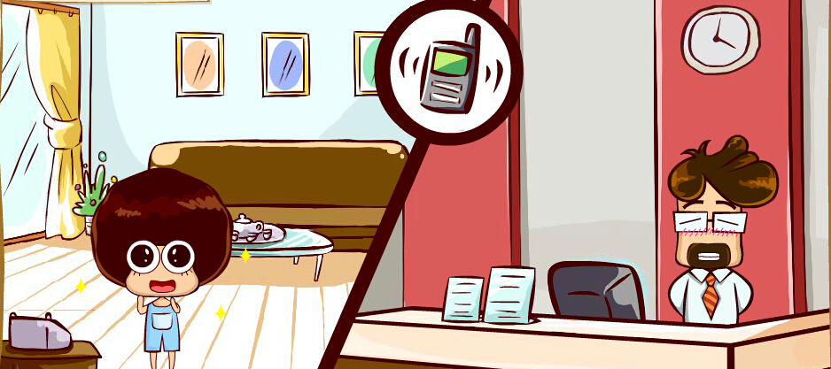
Travel Overseas
住 宿
预订酒店
Booking Room
电话预订酒店
May I speak to someone in the Reservations?
可以让预订部的人接电话吗？
Could you please connect me to the Reservations?
可以把我接到预订部吗？
I’d like to make a reservation.
我想要预定。
对方回应
Reservations speaking, how can I help you?
这里是预订部，有什么可以帮您？

Slide 5
Travel Overseas
住 宿
预订酒店
Booking Room
Useful Expressions
询问空房的日期和房间类型
单人间
single room
Do you have a double room available from Oct. 3rd to 5th?
豪华间
deluxe room
你们有从10月3日到5日空余的双人间吗？
商务间
executive room
I would like to book a double room from Oct 3rd to 5th.
套间
suite
我想订一间10月3日到5日的双人间。
Tips
对方回应
smoking
Yes, we still have availability.
non-smoking
是的我们还有空房。

Slide 6
Travel Overseas
住 宿
预订酒店
Booking Room
询问优惠价格
Do you have any special rate available?
你们有优惠价格吗？
What’s the best rate you can offer?
你们能给我的最优价是多少呢？
Is breakfast included?
包含早餐吗？
对方回应
The current promotional rate is $120 per night, including breakfast.
目前的促销价是120美元一晚，包含早餐。

Slide 7
Travel Overseas
住 宿
预订酒店
Booking Room
完成预订
就订这个。
I’ll take it.
Book it for me.
Let’s book it.

Slide 8
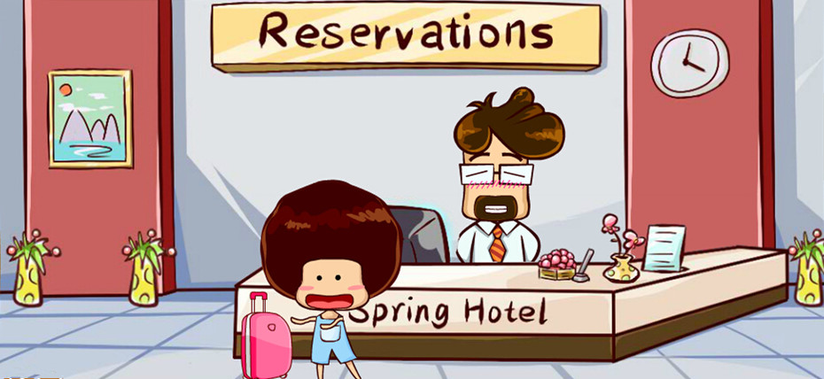
Travel Overseas
住 宿
入住酒店
Checking in
说明自己已有预订
我有预订。
I have a reservation.
I have a room reserved.
There is a room booked in my name.
对方回应
My I have your name, please?
可以告诉我您的名字吗？

Slide 9
Travel Overseas
住 宿
入住酒店
Checking in
对房间位置提出要求
Tips
我可以要二楼的房间吗？
英国
Could you please put me on the second floor?
ground floor 一楼
first floor 二楼
美国
对方回应
first floor 一楼
second floor 二楼
No problem, do you want to pay by credit card or by cash?
没问题，您想用信用卡支付还是付现金？

Slide 10


Travel Overseas
住 宿
入住酒店
Checking in
询问早餐时间
Tips
早餐是几点？
What time is breakfast?
What time do you serve breakfast?
When is breakfast served?
对方回应
Breakfast is between 7:00 and 10:00.
早餐在上午7点到10点供应。

Slide 11
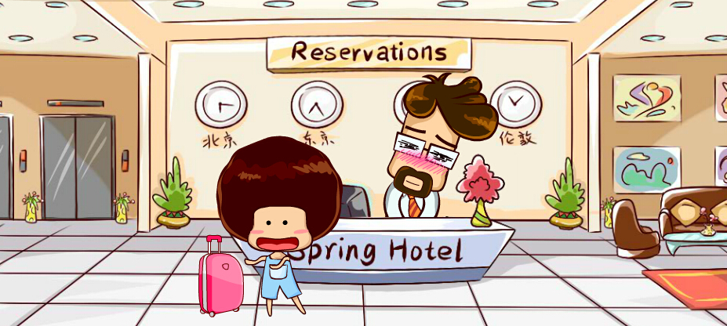
Travel Overseas
住 宿
退房结账
Checking out
提出退房要求
我要退房，谢谢。
I’d like to check out, please.
I need to check out, please.
Could you check me out, please?
I’m checking out today?
对方回应
Your room number, please.
告诉我您的房间号码，谢谢。

Slide 12
Travel Overseas
住 宿
退房结账
Checking out
反馈入住期间体验
对方询问
Useful Expressions
How was your stay?
very nice
一切都还满意吗？
wonderful
应对
impressive
remarkable
很棒，谢谢。
It was great, thank you!

Slide 13
Travel Overseas
吃正餐
Having Dinner
餐厅结账
Paying the Bill
用餐
Notes:
Appetizer-Main Course-Dessert

Slide 14
Travel Overseas
用餐
吃正餐
Having Dinner
请服务员推荐菜品
Useful Expressions
对方询问
appealing
Would you like to order?
tempting
可以点餐了吗？
specialty
应对
是的，它们看起来都不错，你有什么好推荐吗？
Yes, they all look appealing. Do you have any recommendation?
What would you recommend?
What’s your suggestion?
Notes:
询问特色菜
Do you have any specialty?
What is the specialty of the house.

Slide 15



Travel Overseas
用餐
吃正餐
Having Dinner
点牛排
我想要一份顶级肋排。
I’d like an order of prime rib.
Notes:
询问特色菜
Do you have any specialty?
What is the specialty of the house.

Slide 16
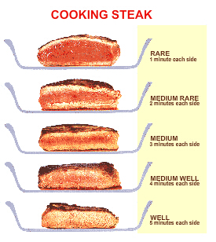
Travel Overseas
用餐
吃正餐
Having Dinner
点牛排
对方询问
How would you like your steak cooked?
How would you like your steak done?
How would you like it?
应对
七分熟，谢谢。
Medium well, please.
Notes:
询问特色菜
Do you have any specialty?
What is the specialty of the house.

Slide 17




Travel Overseas
用餐
吃正餐
Having Dinner
Useful Expressions
点配菜
对方询问
What accompaniments would you like?
What would you like on the side?
您想要什么配菜？
应对
土豆泥，谢谢？
Mashed potatoes, please.
Notes:
询问特色菜
Do you have any specialty?
What is the specialty of the house.

Slide 18
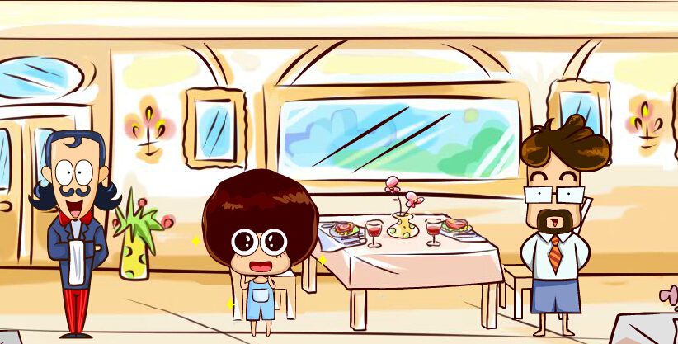
Travel Overseas
用餐
餐厅结账
Paying the Bill
Tips
请服务员拿账单
bill [英] 账单
check [美] 账单
服务员，买单。
Excuse me. Can I have the bill, please?
Excuse me. Could you bring the bill, please?
注意
Excuse me.
抱歉。/打扰一下。
Notes:
询问特色菜
Do you have any specialty?
What is the specialty of the house.

Slide 19
Travel Overseas
用餐
餐厅结账
Paying the Bill
质疑账单
对不起，这一项是什么？
AA制或请客
Excuse me. What is this item.
对方询问
Would you like to split the bill?
Would you like to separate the bill?
Would you like to pay separately?
你们要分开结账吗。
应对
不，一起，今天我请客。
No, together, my treat today.
It’s all on me today.
Notes:
服务员会记下每人分别点的餐。

Slide 20
Travel Overseas
乘坐公交
Taking Bus
出行

Slide 21

Travel Overseas
出行
乘坐公交
Taking Bus
询问路线
Tips
请问这车去唐人街吗？
Hello! Will you go to Chinatown?
Does this bus go to Chinatown?
Is this the right bus to Chinatown?
Is this bus bound for Chinatown?
对方回应
Yes, hop on.
hop-on hop-off bus
是的，上车吧。
Notes:
服务员会记下每人分别点的餐。

Slide 22
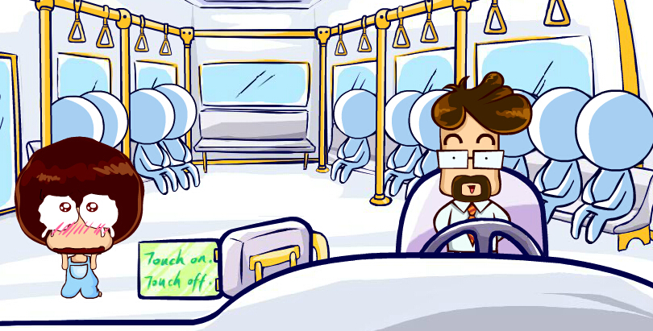
Travel Overseas
出行
乘坐公交
Taking Bus
询问票价
车票多少钱？
What’s the fare, please?
How much is the fare, please?
Chinglish
How much is the ticket, please?
Notes:
服务员会记下每人分别点的餐。

Slide 23
Travel Overseas
出行
乘坐公交
Taking Bus
到站告知
到唐人街时，您能告诉我吗？
Would you please let me know when we are arriving at Chinatown?
Could you let me know when I need to get off?
Tips
国外许多城市的公交车不报站。如果对路线不熟悉，可以请司机提醒自己到站下车。
严格禁止在司机驾车时与司机交谈。
下车时习惯性地向司机表示感谢。
Notes:
服务员会记下每人分别点的餐。

Slide 24
Travel Overseas
问诊
Consulting
就医

Slide 25
Travel Overseas
出行
问诊
Consulting
Useful Expressions
对方询问
头晕
dizzy
What’s the problem?
恶心
nausea
What seems to be the problem?
呕吐
vomit
你哪里不舒服？
发烧
fever
扭伤
sprain
应对
瘀伤
bruise
我头疼，嗓子疼，还流鼻涕。
肿胀
swollen
I got a headache, a sore throat, and a runny nose?
Notes:
服务员会记下每人分别点的餐。

Slide 26
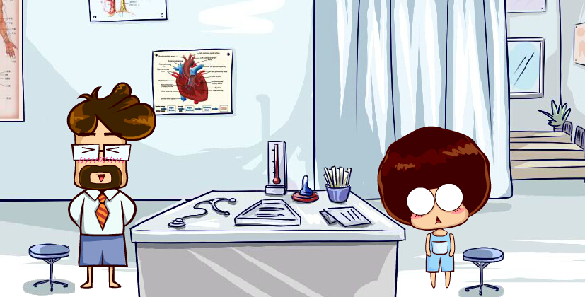
Travel Overseas
出行
问诊
Consulting
Tips
询问病情和医嘱
预约看病
我的病严重吗？
口译服务
Anything serious, doctor?
Can you tell me what’s wrong with me, doctor?
What do you think, doctor?
我需要吃药吗？
Do I need to take some medicine?
Is there anything I can take?
Notes:
服务员会记下每人分别点的餐。

Slide 27
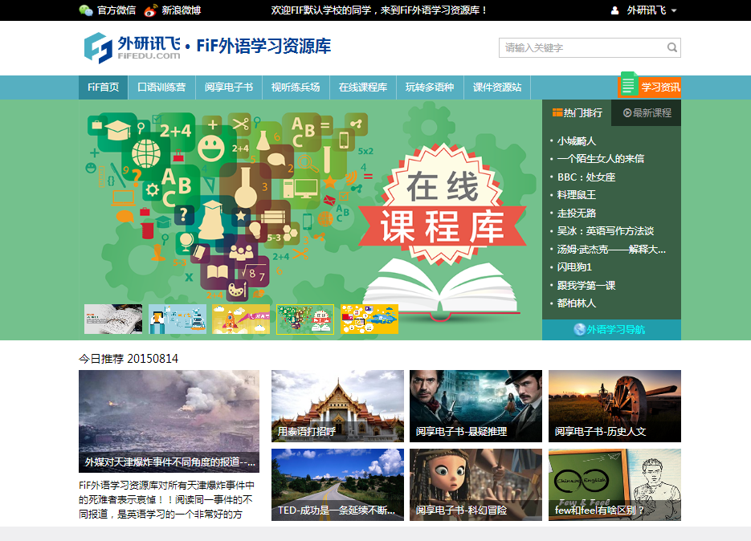
Travel Overseas
FiF外语学习资源库（原iLearning外语学习资源库升级版）
http://lib.fifedu.com
新一代富媒体、多语种的外语学习产品
循序提升听说读写译各项能力，满足外语学习者多种需求
主题全面 海量资源 时效性强 持续更新

Slide 28
Travel Overseas
Thank you!

