Slide 1
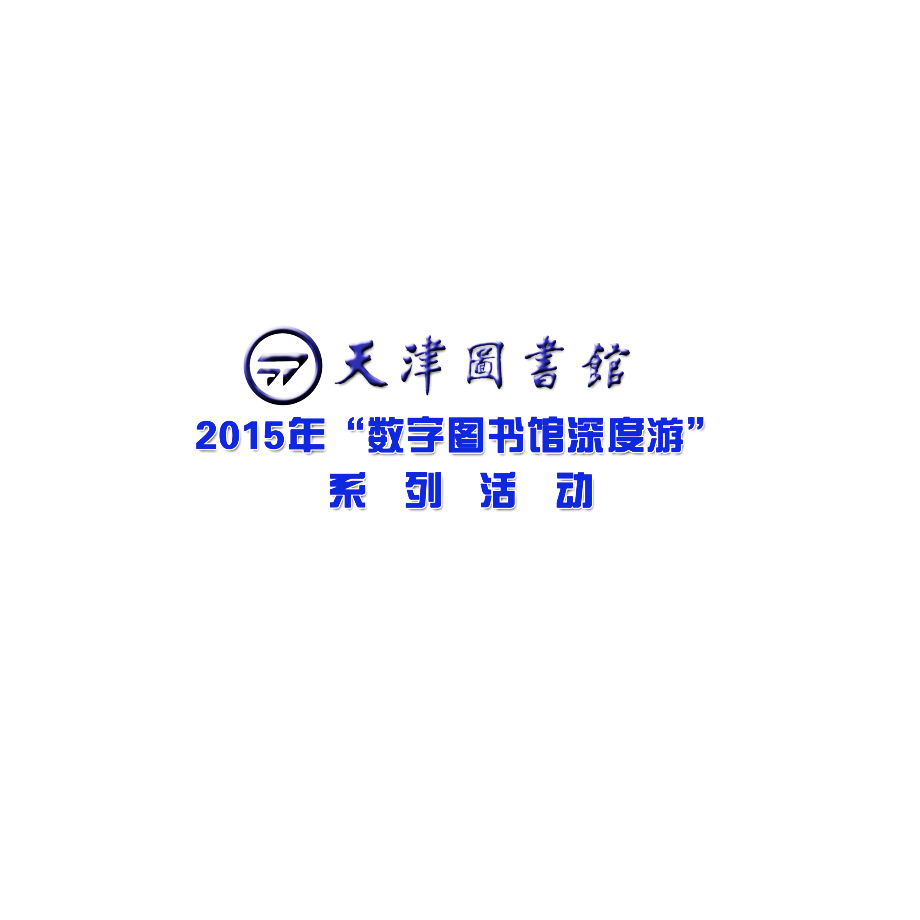
WORD FORMATION
Cherrphonie

Slide 2
In linguistics, Word Formation is the creation of a new word, Word Formation is sometimes contrasted with semantic change, which is a change in a single word’s meaning. The boundary between word formation and semantic change can be difficult to define : a new use of an old word can be seen as a new word derived from an old one and identical to it from.
Word Formation can also be contrasted with the formation of idiomatic expressions, although words can be formed from multi-word phrases.

Slide 3
Q: What you have to remember?

Slide 4
Pronunciation

Slide 5


Slide 6
Spelling

Slide 7
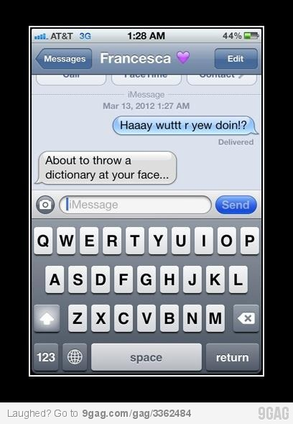

Slide 8
Q: How?

Slide 9
TIPS:
a. pronunciation
b. constitute
c. dictionary
d. your phone

Slide 10
Antidisestablishmentarianism
Antimissile Antibody
Disappear Idealism
Weird Weirdo
Sustainability
Simultaneously translation
Seesaw Ladybird

Slide 11
antidisestablishmentarianism
anti dis establish mentaria nism
反对
否定
建立
精神上的
…学说
反宗教分裂国家学说

Slide 12
anti- 反对的、反抗的
antiwar
anti-japanese
antibody
antibiotic
biology n.
anti-doping
doping

Slide 13
dis- 否定的
dislike
disable
disappear
disaccredit
display
disabuse
discover
disaccord
disappoint
disaffect

Slide 14
mentaria
---mental 精神上的
judgmental governmental

Slide 15
-ism 主义、制度、派别
idealism
sexism
materialism （material ）
albinism （albin )
modernism （modern ）
humanism
escapism （escape ）
absurdism （absurd）

Slide 16
初级
How to read it.
How to spell it.
words
Then how to spell it.
Then how to repeat it.

Slide 17
sustainability
simultaneously
interpretation
concentration

Slide 18
鹅鹅鹅，曲项向天歌
duck singing to the sky

Slide 19
The Word’s Combination

Slide 20
handball
football
basketball

Slide 21
The dictionary

Slide 22
seesaw
ladybird

Slide 23
Change Everything
Into English

Slide 24
KFC
Kentucky Fried Chicken
麦当劳
Mcdonald’s
星巴克
Starbacks
Adidas
Impossible is nothing
Nike
Just do it

Slide 25
Word Formation

Slide 26
前缀改词义 unhappy
后缀改词性 teacher

Slide 27
* multi- 多种多样的
multimedia
multinational
multidirectional (directional)
multicultural (cultural)

Slide 28
*semi- 半个的、一半的
semicircle
semifinal
semihuman
semimonthly（monthly）

Slide 29
*ex- 上一任的
ex-wife
ex-girlfriend
export
excessive heat

Slide 30
*in-,im- 向里、朝里
inbox
imported
income
internal

Slide 31
*out- 向外的
outbox
outcome
outstanding
outnumber(weigh\heigh)

Slide 32
* -proof 防、抵抗
waterproof
fireproof
shake-proof
milkshake

Slide 33
* bi- 表示双的
bicycle
biweekly
bigamy (gam)

Slide 34
* tri- 表示三个的
tricycle
triangle
tripod
trilogy

Slide 35
* inter- 之间的
internet
international
interpersonal
interaction

Slide 36
* post- 稍候、推迟（邮寄）
* under- 在…下面\之前
postpone
undergraduate
postgraduate

Slide 37
* sub- 在下面的，之下的
subway
subtitle
submarine
subcontractor

Slide 38
* -wise 向着…的方向（聪明的人）
clockwise
counter-clockwise
pairwise
otherwise

Slide 39
Word Family

Slide 40
educate v.
education n.
educator n.
educative adj.

Slide 41
THE END

